Slide 1
Agile – Scrum and SAFe Basics with insights on leveraging GenAI in Agile for Scrum Masters
By Srini B
Agile Coach, Prince 2 Practitioner
Certified PSM,PSPO,SAFe
Certified GenenerativeAI Leader

Slide 2
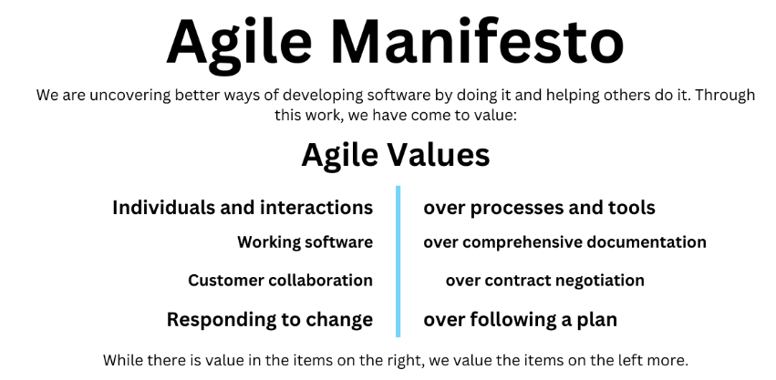
What is Agile !
Agile is a set of values, principles, and practices that enable individuals and teams to create and respond to change in uncertain environments.
In Simple Words Agile is a way of working (or mindset)
Agile focuses on:
✅ Breaking work into small pieces (called iterations or sprints) ✅ Delivering value early and often instead of waiting till the end ✅ Adapting to change quickly rather than sticking to a rigid plan ✅ Working closely with customers to build the right thing ✅ Empowering teams to self-organize and collaborate
“Learn from yesterday, live for today, hope for tomorrow. The important thing is not to stop questioning.” Albert Einstein

Slide 3
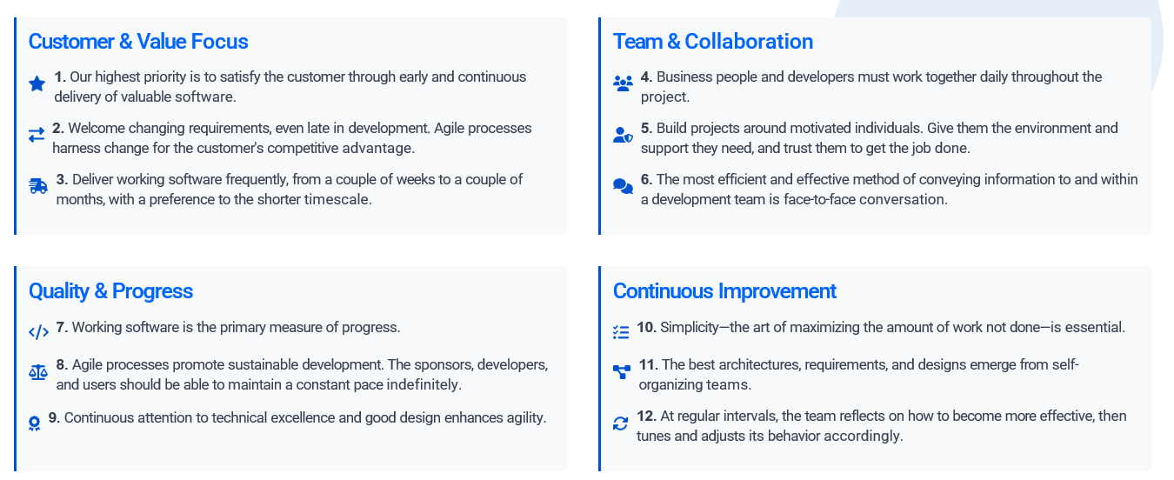
12 Agile Principles

Slide 4
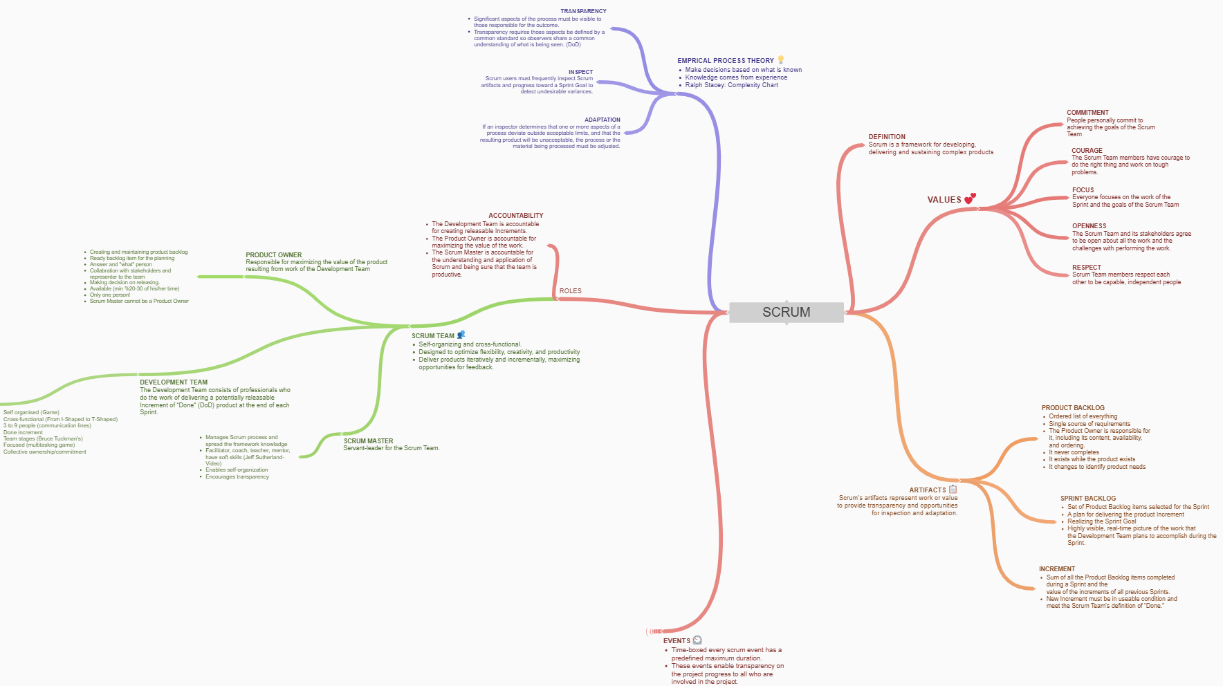
Scrum 3-5-3-5-3

Slide 5
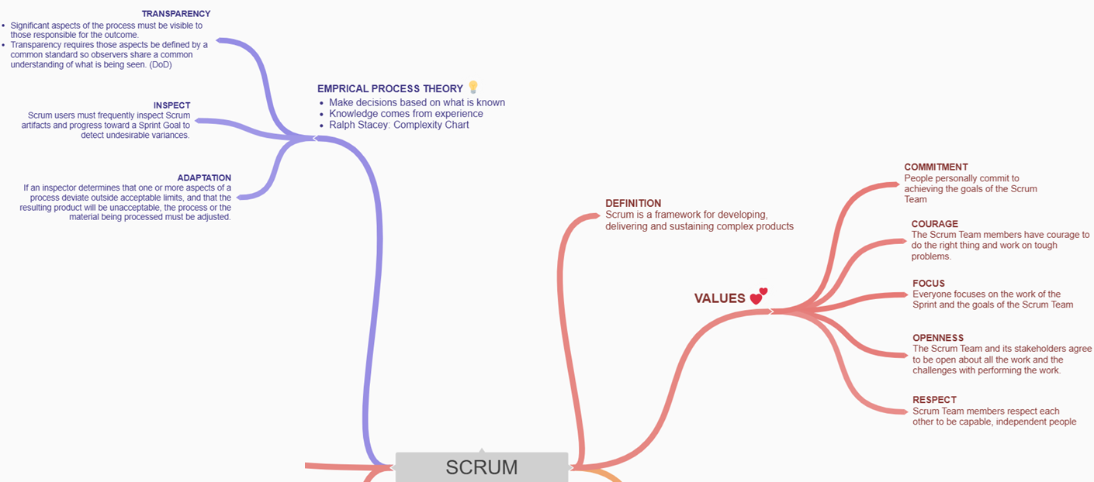
3 Pillars and 5 Values of Scrum

Slide 6
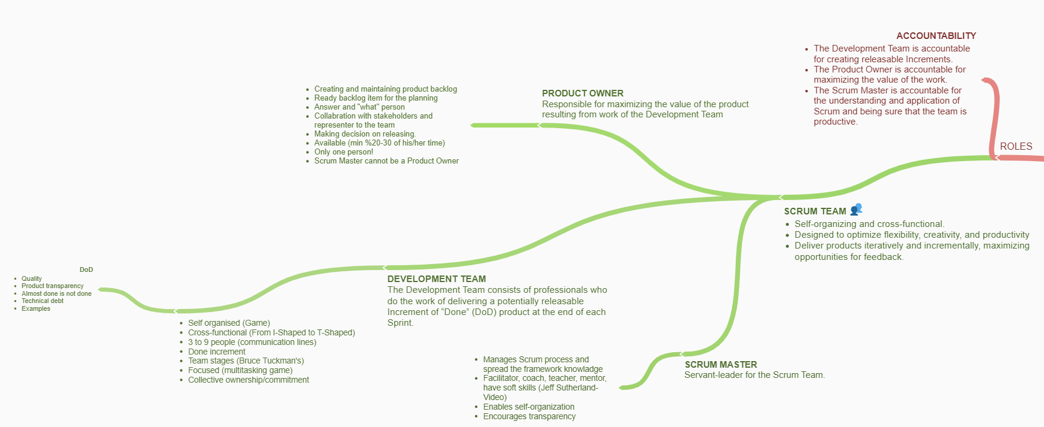
Scrum- 3 Roles

Slide 7
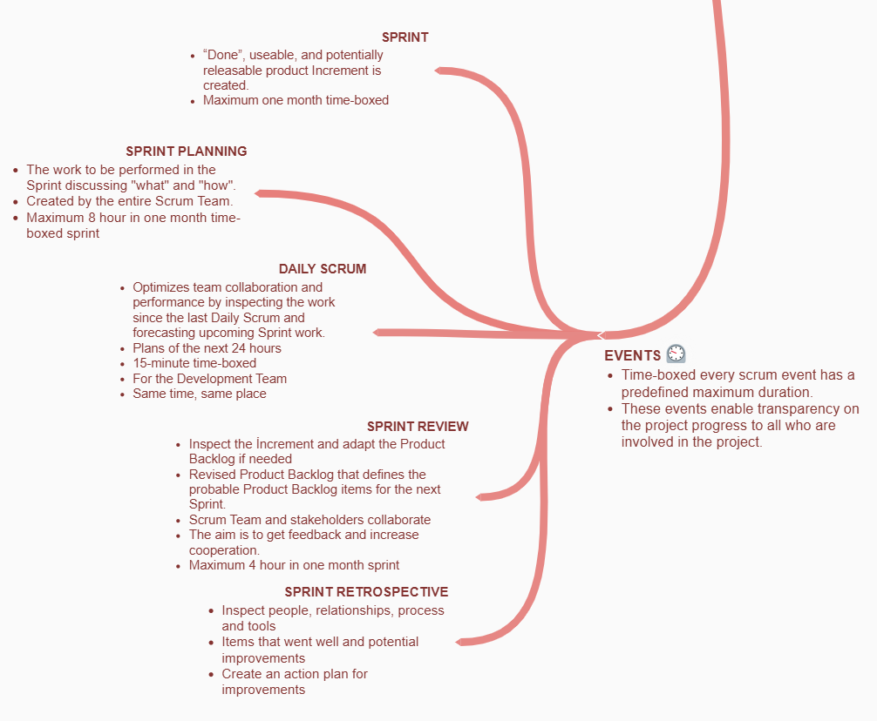
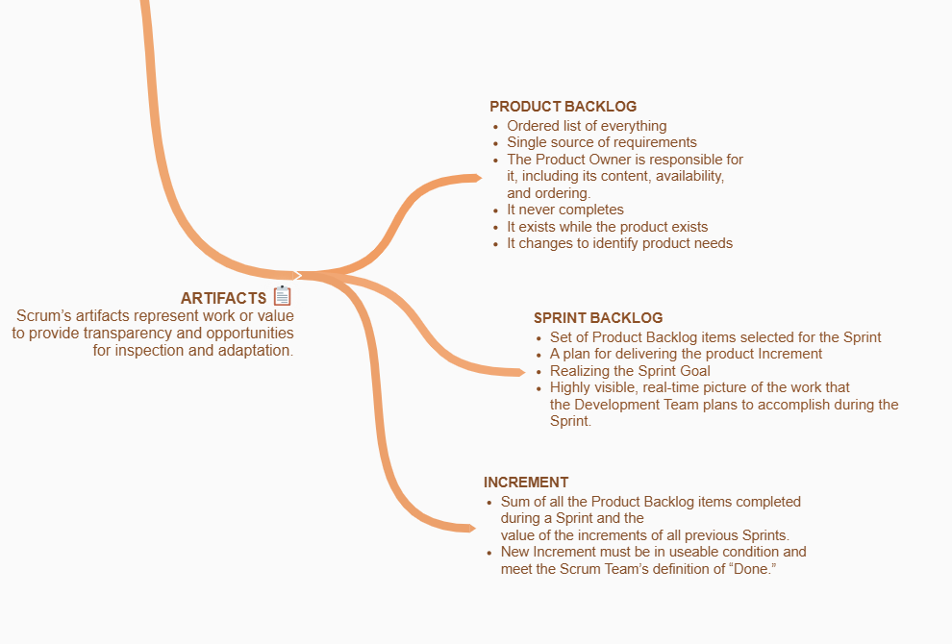
Scrum – 5 Events 3 Key Artifacts…

Slide 8
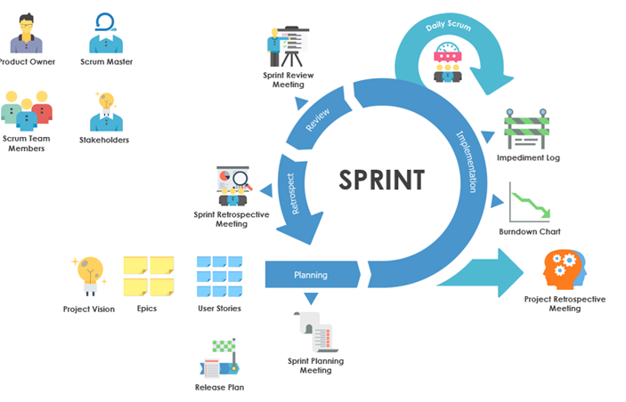
Typical Sprint 1/2/3/4 Weeks

Slide 9
AI Tools for Scrum Team
Tool | Use Case Highlights | Feature Example
ClickUp AI | Sprint planning, status reports, documentation | Task suggestions, AI summaries
Jira Assist | Backlog grooming, risk detection, sprint analytics | Auto-issue creation, timeline prediction
Plandek | Metrics management, delivery optimization | DORA metrics analysis
Notion AI | Meeting note automation | Transcription, summary
Parabol | Retrospective analysis | Pattern and sentiment identification
Otter AI | Meeting facilitation | Automatic action item extraction
ScrumDo | Predictive sprint management | Capacity recommendations, trend analysis

Slide 10
Top AI Plugins for Jira Workflows
Plugin Name | Key Features & Benefits | Highlights
Smart AI for Jira | - AI-powered ticket creation, issue analysis, workflow automation - Uses OpenAI, Azure, Gemini - Summarizes tickets, refines descriptions, generates replies, creates child tasks with one click | - AI chat for Acceptance Criteria, Definition of Done, test cases - Quick actions for comments and updates
AI Jeannie | - Drafts epic descriptions, user story descriptions, and acceptance criteria- Designed for business analysts | - Fast Agile content creation in Jira
Jira Assistant AI | - Smart issue prioritization, automated status updates, progress tracking - Personalized dashboard, natural language commands | - Free tier available, learns work patterns for daily workflow optimization
Codeium AI/Windsurf | - Links code changes to tickets, helps technical debt management - Creates tickets from code comments/commits | - Integrates with GitHub, GitLab, Bitbucket
JAI – Jira AI Autocomplete | - Autocomplete issue description, generates JQL from natural language - Boosts accuracy in ticket creation/assignment | - Converts natural language to Jira queries
AI for Jira (XDevPod) | - Integrates with Atlassian Rovo agents for chat, translation and JQL management - JQL Expert helps generate, interpret, compare JQL | - Custom agent chat, translation of issues

Slide 11
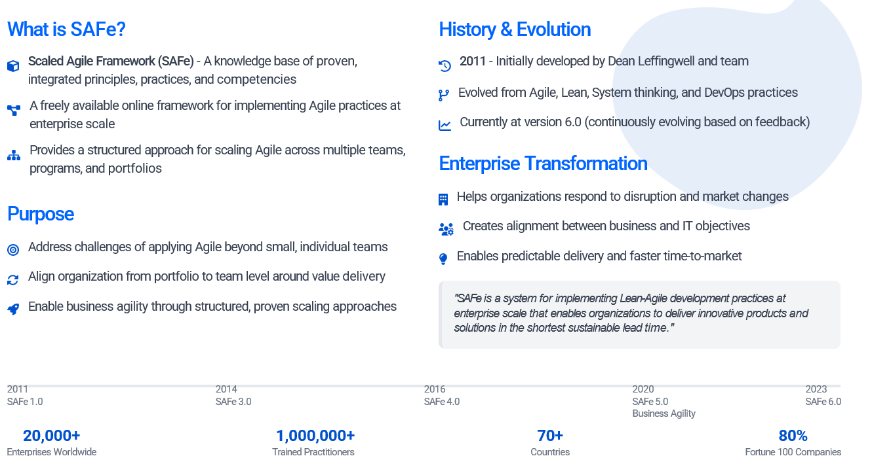
What is SAFe?
In short: Scrum = small team Agile SAFe = enterprise-level Agile

Slide 12
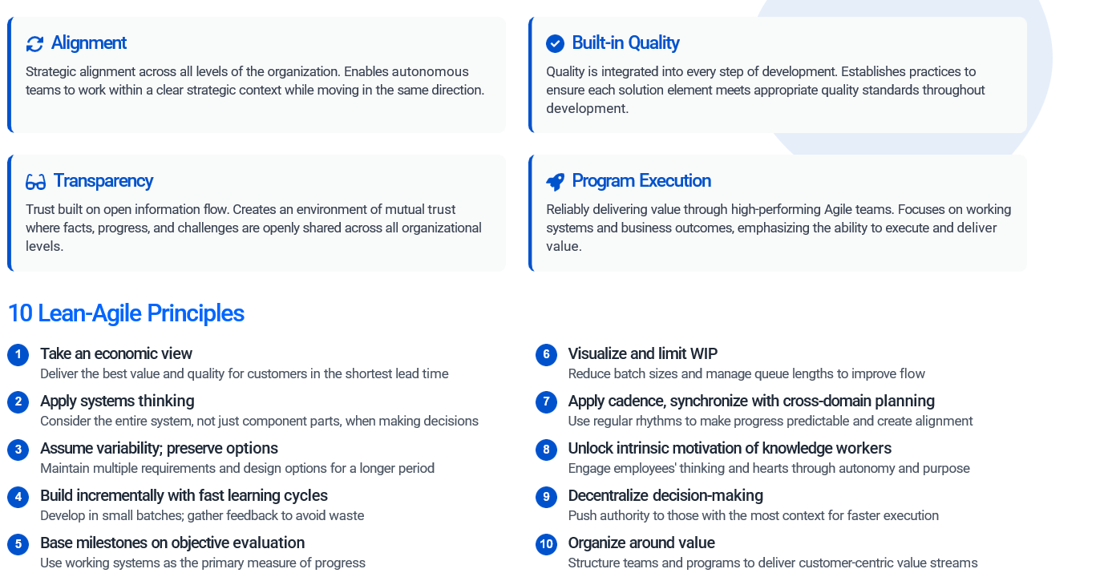
SAFe 4 Values 10 Principles

Slide 13
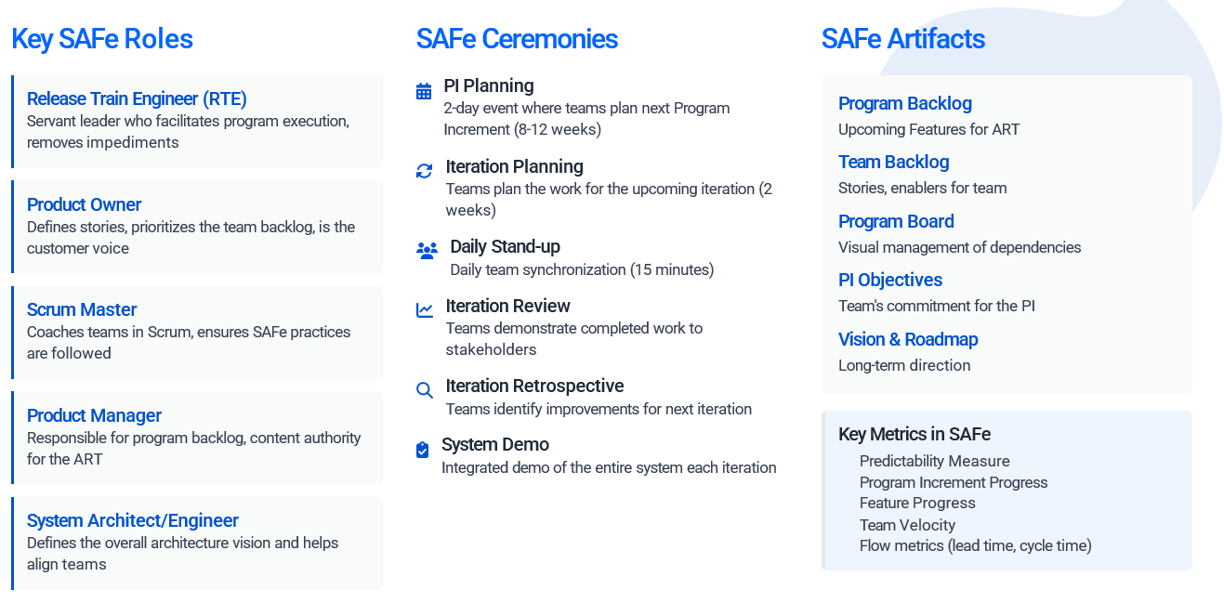
SAFe Roles, Ceremonies & Artifacts

Slide 14
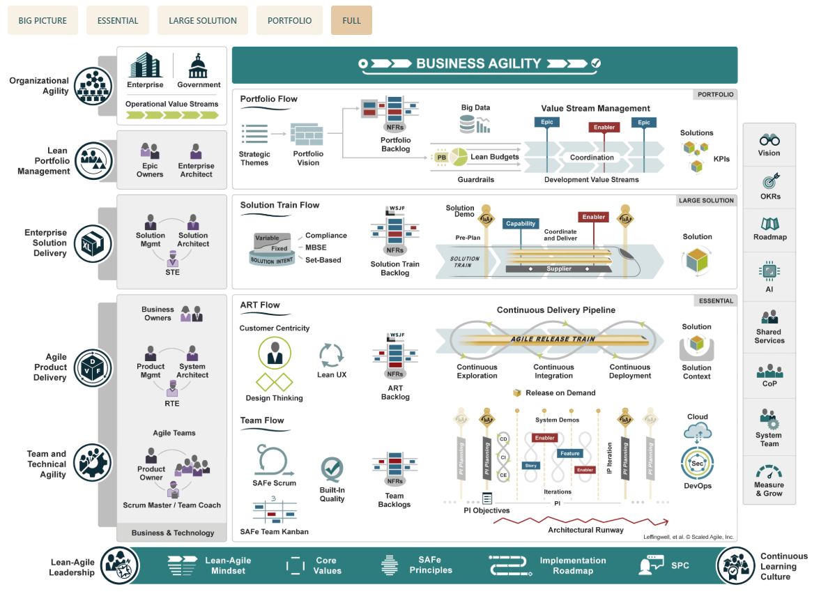
SAFe Full

Slide 15
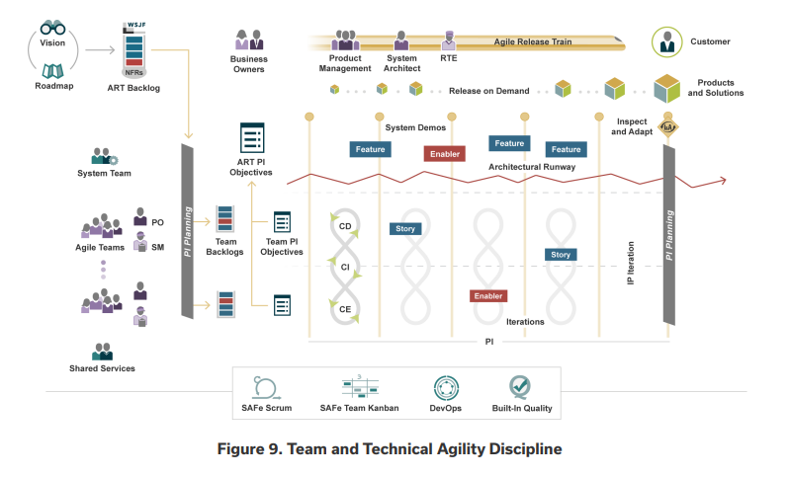
Focused ART Level View
ART Size Guidelines
Each Agile Team → 5 to 11 members (including PO & SM).
Each ART → 5 to 12 Agile Teams.
So, an ART typically has about: 50 to 125 people in total.
Best setup for ART is ~100 people, split across 8–10 Agile Teams

Slide 16
Scrum and SAFe Certificates
Scrum.org Certifications
Professional Scrum Master I (PSM I)
Professional Scrum Master II (PSM II)
Professional Scrum Master III (PSM III)
Professional Scrum Product Owner I (PSPO I)
Professional Scrum Product Owner II (PSPO II)
Professional Scrum Product Owner III (PSPO III)
Professional Scrum Developer (PSD)
Scaled Professional Scrum (SPS)
Professional Agile Leadership™ (PAL I)
Professional Scrum with Kanban™ (PSK I)
Professional Scrum Facilitation Skills™ (PSFS)
Professional Scrum with User Experience™ (PSU I)
SAFe 6.0 Certification List
SAFe Agilist (SA) / Leading SAFe®
SAFe Scrum Master (SSM)
SAFe Advanced Scrum Master (SASM)
SAFe Product Owner/Product Manager (POPM)
SAFe Agile Product Manager (APM)
SAFe Practitioner (SP) / SAFe for Teams
SAFe Release Train Engineer (RTE)
SAFe Architect (ARCH)
SAFe DevOps Practitioner (SDP)
SAFe Lean Portfolio Manager (LPM)
SAFe for Government
SAFe for Hardware / SAFe Hardware Agilist (SHWA)
SAFe for Hardware Teams / SAFe Hardware Practitioner (SHWP)
SAFe Agile Software Engineer (ASE)
SAFe Program Consultant (SPC)

Slide 17

“Agile is an attitude, not a technique with boundaries. An attitude has no boundaries, so we wouldn’t ask ‘can I use Agile here,’ but rather ‘how would I act in the Agile way here,’ or ‘How Agile can we be here?” —Alistair Cockburn, Agile Software Development

Slide 18
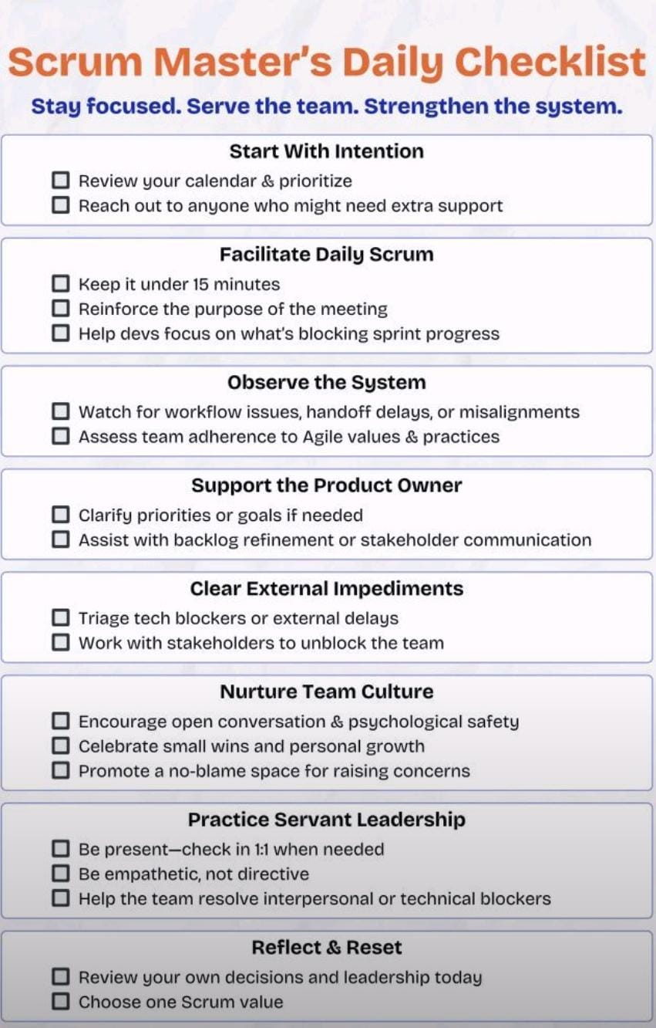
Scrum Master Checklist

Slide 19
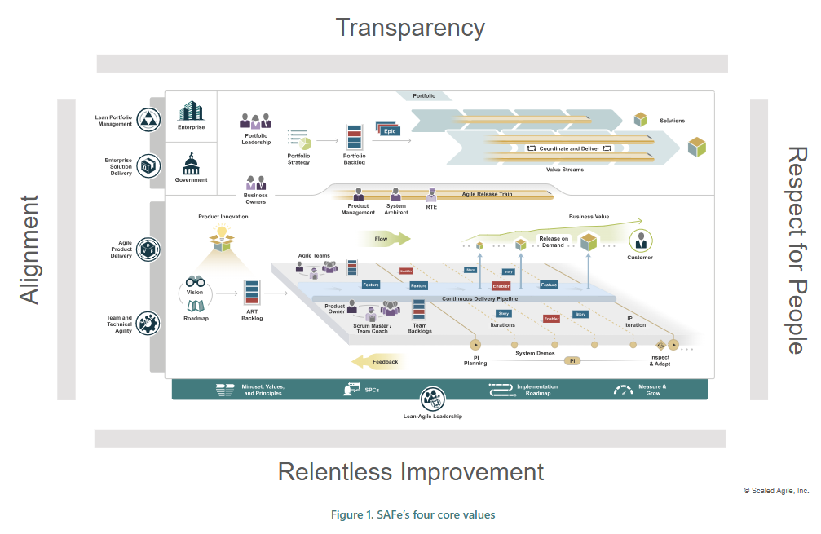
SAFe Core Values - 4

Slide 20
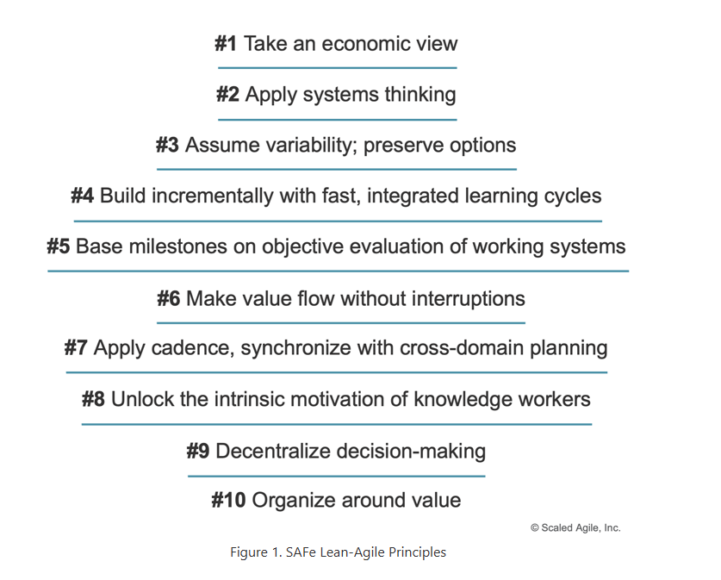
SAFe Principles – 10

Slide 21
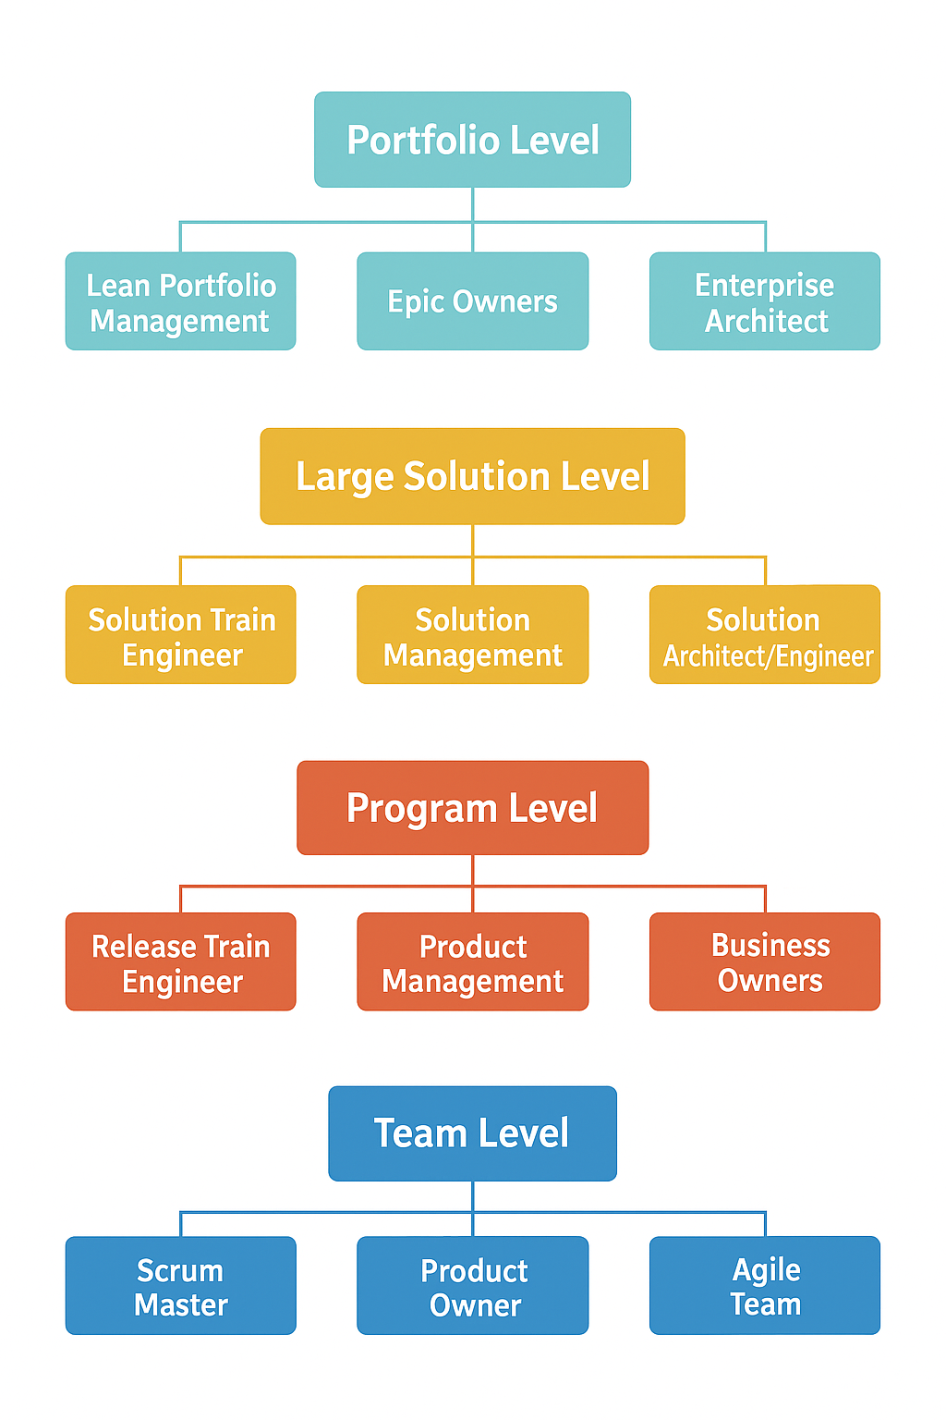
Roles in SAFe – 4 levels
SAFe organizes roles into 4 levels (depending on the configuration an enterprise uses):
Team Level → PO, Scrum Master, Agile Team
Program Level → RTE, Product Management, System Architect, Business Owners
Large Solution Level → STE, Solution Management, Solution Architect
Portfolio Level → LPM, Epic Owners, Enterprise Architect
Think of it like this:
Team Level = Build the product
Program Level = Coordinate multiple teams
Large Solution = Coordinate multiple programs
Portfolio = Align with enterprise strategy

